Slide 1
UNIT-2
Virtualization

Slide 2
Introduction:
Virtualization is a large umbrella of technologies and concepts that are meant to provide an abstract environment whether virtual hardware or an operating system to run applications.
Virtualization Technology is one of the fundamental components of cloud computing, especially in regard to Infrastructure-based services.
Virtualization allows the creation of a secure, customizable, and isolated execution environment for running applications.
These environments are called virtual because they simulates the interface that is expected by a guest.
Ex:- Hardware Virtualization, Storage & Network Virtualization.
Virtualization is widely used to deliver customizable computing environments on demand.

Slide 3
Major causes for the diffusion of hardware virtualization solutions are:
Increased Performance and Computing Capacity
Underutilized hardware and software resources
Lack of space
Greening initiatives
Rise of administrative costs

Slide 4
In a Virtualized Environment, there are three major components:
Guest: The Guest represents the system component that interacts with the virtualization layer rather than with the host.
Virtualization Layer: The virtualization Layer is responsible for recreating the same or a different environment where the guest will operate
Host: The Host represents the original environment where the guest is supposed to be managed.

Slide 5
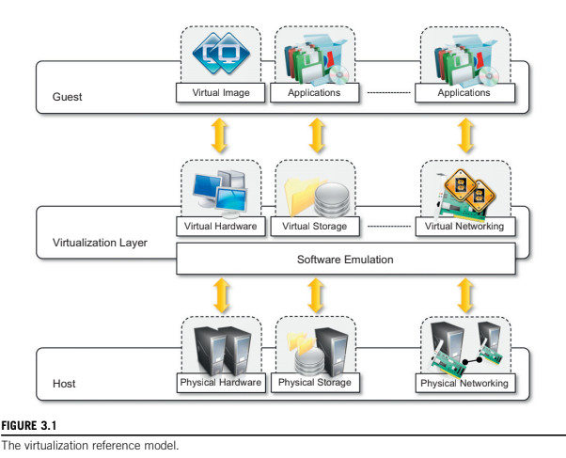
The Virtualization Reference Model

Slide 6
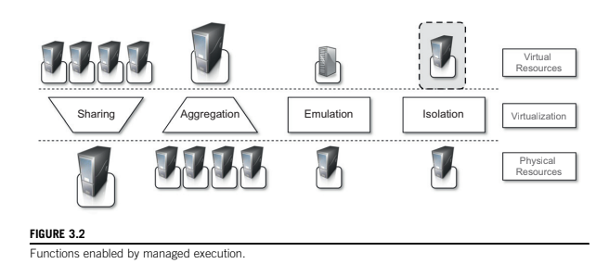
Characteristics of Virtualized Environments:
Increased Security
Managed Execution

Slide 7
Characteristics of Virtualized Environments:
Managed Execution
Sharing
Aggregation
Emulation
Isolation
Portability

Slide 8
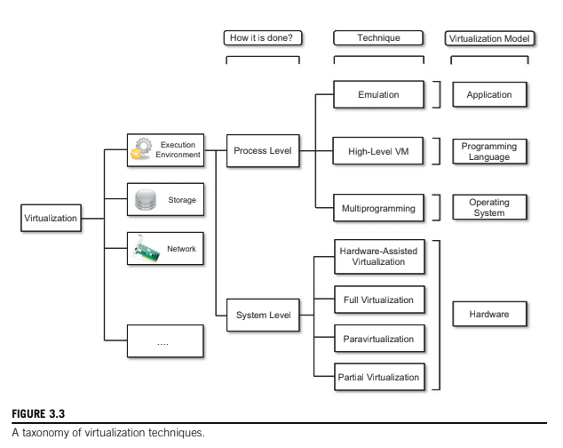
TAXONOMY OF VIRTUALIZATION TECHNIQUES:
A classification of Virtualization Techniques helps in understanding the characteristics and use of these techniques:

Slide 9
TAXONOMY OF VIRTUALIZATION TECHNIQUES:
The first classification discriminates against the service or entity that is being emulated. Virtualization is mainly used to emulate execution environments, storage, and networks.
Among these categories, execution virtualization constitutes the oldest, most popular, and most developed area.
In particular we can divide these execution virtualization techniques into two major categories by considering the type of host they require.
Process-level techniques are implemented on top of an existing operating system, which has full control of the hardware.
System-level techniques are implemented directly on hardware and do not require or require a minimum of support from an existing operating system.
Within these two categories we can list various techniques that offer the guest a different type of virtual computation environment: bare hardware, operating system resources, low-level programming language, and application libraries.

Slide 10
TAXONOMY OF VIRTUALIZATION TECHNIQUES:
Execution Virtualization
Machine Reference Model
Hardware-Level Virtualization
Hardware Virtualization Techniques
Operating System Level Virtualization
Programming Language Level Virtualization
Application Level Virtualization

Slide 11
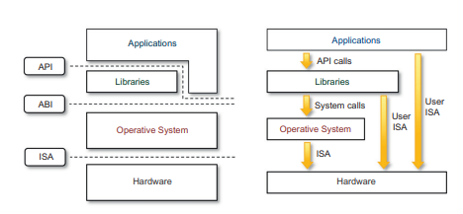
TAXONOMY OF VIRTUALIZATION TECHNIQUES:
Execution Virtualization
Machine Reference Model

Slide 12
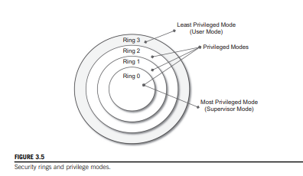
TAXONOMY OF VIRTUALIZATION TECHNIQUES:
Execution Virtualization
Machine Reference Model

Slide 13
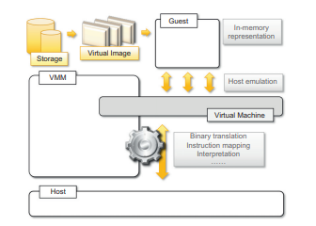
TAXONOMY OF VIRTUALIZATION TECHNIQUES:
Execution Virtualization
Hardware-Level Virtualization

Slide 14
TAXONOMY OF VIRTUALIZATION TECHNIQUES:
Execution Virtualization
Hardware-Level Virtualization
Hypervisors:
A fundamental element of hardware virtualization is the hypervisor, or virtual machine manager (VMM). It recreates a hardware environment in which guest operating systems are installed.
There are two major types of hypervisor: Type I and Type II (see Figure 3.7).
Type I hypervisors run directly on top of the hardware. Therefore, they take the place of the operating systems and interact directly with the ISA interface exposed by the underlying hardware, and they emulate this interface in order to allow the management of guest operating systems. This type of hypervisor is also called a native virtual machine since it runs natively on hardware.
Type II hypervisors require the support of an operating system to provide virtualization services. This means that they are programs managed by the operating system, which interact with it through the ABI and emulate the ISA of virtual hardware for guest operating systems. This type of hypervisor is also called a hosted virtual machine since it is hosted within an operating system.

Slide 15
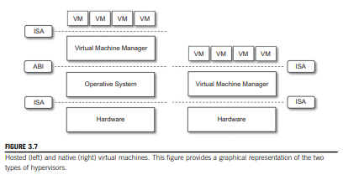
TAXONOMY OF VIRTUALIZATION TECHNIQUES:
Execution Virtualization
Hardware-Level Virtualization
Hypervisors:

Slide 16
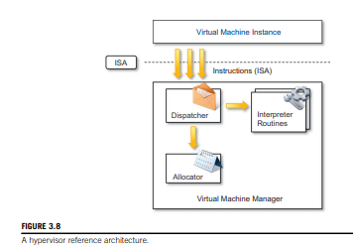
TAXONOMY OF VIRTUALIZATION TECHNIQUES:
Execution Virtualization
Hardware-Level Virtualization
Hypervisors:

Slide 17
TAXONOMY OF VIRTUALIZATION TECHNIQUES:
Execution Virtualization
Hardware-Level Virtualization
Hypervisors:
Conceptually, a virtual machine manager is internally organized as described in Figure 3.8.
Three main modules, dispatcher, allocator, and interpreter, coordinate their activity in order to emulate the underlying hardware.
The dispatcher constitutes the entry point of the monitor and reroutes the instructions issued by the virtual machine instance to one of the two other modules.
The allocator is responsible for deciding the system resources to be provided to the VM: whenever a virtual machine tries to execute an instruction that results in changing the machine resources associated with that VM, the allocator is invoked by the dispatcher.
The interpreter module consists of interpreter routines. These are executed whenever a virtual machine executes a privileged instruction: a trap is triggered and the corresponding routine is executed.
The design and architecture of a virtual machine manager, together with the underlying hardware design of the host machine, determine the full realization of hardware virtualization, where a guest operating system can be transparently executed on top of a VMM as though it were run on the underlying hardware.

Slide 18
TAXONOMY OF VIRTUALIZATION TECHNIQUES:
Execution Virtualization
Hardware-Level Virtualization
Hypervisors:
Three properties have to be satisfied:
Equivalence: A guest running under the control of a virtual machine manager should exhibit the same behavior as when it is executed directly on the physical host
Resource control: The virtual machine manager should be in complete control of virtualized resources.
Efficiency: A statistically dominant fraction of the machine instructions should be executed without intervention from the virtual machine manager.
The major factor that determines whether these properties are satisfied is represented by the layout of the ISA of the host running a virtual machine manager.

Slide 19
TAXONOMY OF VIRTUALIZATION TECHNIQUES:
Execution Virtualization
Hardware-Level Virtualization
Hypervisors:
Popek and Goldberg provided a classification of the instruction set and proposed three theorems that define the properties that hardware instructions need to satisfy in order to efficiently support virtualization.
THEOREM 1: For any conventional third-generation computer, a VMM may be constructed if the set of sensitive instructions for that computer is a subset of the set of privileged instructions.
THEOREM 2: A conventional third-generation computer is recursively virtualizable if:
It is virtualizable, and
A VMM without any timing dependencies can be constructed for it.
THEOREM 3: A hybrid VMM may be constructed for any conventional third-generation machine in which the set of user-sensitive instructions is a subset of the set of privileged instructions

Slide 20
TAXONOMY OF VIRTUALIZATION TECHNIQUES:
Execution Virtualization
Hardware Virtualization Techniques
Hardware –assisted Virtualization
Full Virtualization
Paravirtualization
Partial Virtualization

Slide 21
TAXONOMY OF VIRTUALIZATION TECHNIQUES:
Execution Virtualization
Hardware Virtualization Techniques
Hardware –assisted Virtualization:
This term refers to a scenario in which the hardware provides architectural support for building a virtual machine manager able to run a guest operating system in complete isolation.
This technique was originally introduced in the IBM System/370. At present, examples of hardware-assisted virtualization are the extensions to the x86-64 bit architecture introduced with Intel VT (formerly known as Vanderpool) and AMD V (formerly known as Pacifica).
These extensions, which differ between the two vendors, are meant to reduce the performance penalties experienced by emulating x86 hardware with hypervisors.
Before the introduction of hardware-assisted virtualization, software emulation of x86 hardware was significantly costly from the performance point of view. The reason for this is that by design the x86 architecture did not meet the formal requirements introduced by Popek and Goldberg, and early products were using binary translation to trap some sensitive instructions and provide an emulated version.
Products such as VMware Virtual Platform, introduced in 1999 by VMware, which pioneered the field of x86 virtualization, were based on this technique.
After 2006, Intel and AMD introduced processor extensions, and a wide range of virtualization solutions took advantage of them: Kernel-based Virtual Machine (KVM), VirtualBox, Xen, VMware, Hyper-V, Sun xVM, Parallels, and others.

Slide 22
TAXONOMY OF VIRTUALIZATION TECHNIQUES:
Execution Virtualization
Hardware Virtualization Techniques
Full Virtualization:
Full virtualization refers to the ability to run a program, most likely an operating system, directly on top of a virtual machine and without any modification, as though it were run on the raw hardware.
To make this possible, virtual machine managers are required to provide a complete emulation of the entire underlying hardware.
The principal advantage of full virtualization is complete isolation, which leads to enhanced security, ease of emulation of different architectures, and coexistence of different systems on the same platform.
Whereas it is a desired goal for many virtualization solutions, full virtualization poses important concerns related to performance and technical implementation.
A key challenge is the interception of privileged instructions such as I/O instructions: Since they change the state of the resources exposed by the host, they have to be contained within the virtual machine manager. A simple solution to achieve full virtualization is to provide a virtual environment for all the instructions, thus posing some limits on performance.
A successful and efficient implementation of full virtualization is obtained with a combination of hardware and software, not allowing potentially harmful instructions to be executed directly on the host. This is what is accomplished through hardware-assisted virtualization.

Slide 23
TAXONOMY OF VIRTUALIZATION TECHNIQUES:
Execution Virtualization
Hardware Virtualization Techniques
Paravirtualization:
This is a not-transparent virtualization solution that allows implementing thin virtual machine managers.
Paravirtualization techniques expose a software interface to the virtual machine that is slightly modified from the host and, as a consequence, guests need to be modified.
The aim of paravirtualization is to provide the capability to demand the execution of performance critical operations directly on the host, thus preventing performance losses that would otherwise be experienced in managed execution.
This allows a simpler implementation of virtual machine managers that have to simply transfer the execution of these operations, which were hard to virtualize, directly to the host.
To take advantage of such an opportunity, guest operating systems need to be modified and explicitly ported by remapping the performance-critical operations through the virtual machine software interface.
This is possible when the source code of the operating system is available, and this is the reason that paravirtualization was mostly explored in the opensource and academic environment.
Whereas this technique was initially applied in the IBM VM operating system families, the term paravirtualization was introduced in literature in the Denali project [24] at the University of Washington.

Slide 24
TAXONOMY OF VIRTUALIZATION TECHNIQUES:
Execution Virtualization
Hardware Virtualization Techniques
Paravirtualization:
This technique has been successfully used by Xen for providing virtualization solutions for Linux-based operating systems specifically ported to run on Xen hypervisors.
Operating systems that cannot be ported can still take advantage of paravirtualization by using ad hoc device drivers that remap the execution of critical instructions to the paravirtualization APIs exposed by the hypervisor.
Xen provides this solution for running Windows-based operating systems on x86 architectures.
Other solutions using paravirtualization include VMWare, Parallels, and some solutions for embedded and real-time environments such as TRANGO, Wind River, and XtratuM.

Slide 25
TAXONOMY OF VIRTUALIZATION TECHNIQUES:
Execution Virtualization
Hardware Virtualization Techniques
Partial Virtualization:
Partial virtualization provides a partial emulation of the underlying hardware, thus not allowing the complete execution of the guest operating system in complete isolation.
Partial virtualization allows many applications to run transparently, but not all the features of the operating system can be supported, as happens with full virtualization.
An example of partial virtualization is address space virtualization used in time-sharing systems; this allows multiple applications and users to run concurrently in a separate memory space, but they still share the same hardware resources (disk, processor, and network).
Historically, partial virtualization has been an important milestone for achieving full virtualization, and it was implemented on the experimental IBM M44/44X.
Address space virtualization is a common feature of contemporary operating systems.

Slide 26
TAXONOMY OF VIRTUALIZATION TECHNIQUES:
Execution Virtualization
Operating System Level Virtualization:
Operating system-level virtualization offers the opportunity to create different and separated execution environments for applications that are managed concurrently.
Differently from hardware virtualization, there is no virtual machine manager or hypervisor, and the virtualization is done within a single operating system, where the OS kernel allows for multiple isolated user space instances.
The kernel is also responsible for sharing the system resources among instances and for limiting the impact of instances on each other.
A user space instance in general contains a proper view of the file system, which is completely isolated, and separate IP addresses, software configurations, and access to devices.
Operating systems supporting this type of virtualization are general-purpose, timeshared operating systems with the capability to provide stronger namespace and resource isolation.
Compared to hardware virtualization, this strategy imposes little or no overhead because applications directly use OS system calls and there is no need for emulation.
There is no need to modify applications to run them, nor to modify any specific hardware, as in the case of hardware-assisted virtualization.

Slide 27
TAXONOMY OF VIRTUALIZATION TECHNIQUES:
Execution Virtualization
Operating System Level Virtualization:
On the other hand, operating system-level virtualization does not expose the same flexibility of hardware virtualization, since all the user space instances must share the same operating system.
This technique is an efficient solution for server consolidation scenarios in which multiple application servers share the same technology: operating system, application server framework, and other components.
When different servers are aggregated into one physical server, each server is run in a different user space, completely isolated from the others.
Examples of operating system-level virtualizations are FreeBSD Jails, IBM Logical Partition (LPAR), SolarisZones and Containers, Parallels Virtuozzo Containers, OpenVZ, iCore Virtual Accounts, Free Virtual Private Server (FreeVPS), and others.
The services offered by these technologies differ, and most of them are available on Unix-based systems. Some of them, such as Solaris and OpenVZ, allow for different versions of the same operating system to operate concurrently.

Slide 28
TAXONOMY OF VIRTUALIZATION TECHNIQUES:
Execution Virtualization
Programming-Language-Level Virtualization:
Programming language-level virtualization is mostly used to achieve ease of deployment of applications, managed execution, and portability across different platforms and operating systems.
It consists of a virtual machine executing the byte code of a program, which is the result of the compilation process.
Compilers implemented and used this technology to produce a binary format representing the machine code for an abstract architecture.
Generally, these virtual machines constitute a simplification of the underlying hardware instruction set and provide some high-level instructions that map some of the features of the languages compiled for them.
At runtime, the byte code can be either interpreted or compiled on the fly—or jitted—against the underlying hardware instruction set.
Programming language-level virtualization has a long trail in computer science history and originally was used in 1966 for the implementation of Basic Combined Programming Language (BCPL), a language for writing compilers and one of the ancestors of the C programming language.
Other important examples of the use of this technology have been the UCSD Pascal and Smalltalk.

Slide 29
TAXONOMY OF VIRTUALIZATION TECHNIQUES:
Execution Virtualization
Programming-Language-Level Virtualization:
Virtual machine programming languages become popular again with Sun’s introduction of the Java platform in 1996.
The Java virtual machine was originally designed for the execution of programs written in the Java language, but other languages such as Python, Pascal, Groovy, and Ruby were made available.
The ability to support multiple programming languages has been one of the key elements of the Common Language Infrastructure (CLI), which is the specification behind .NET Framework.
Currently, the Java platform and .NET Framework represent the most popular technologies for enterprise application development.
The main advantage of programming-level virtual machines, also called process virtual machines, is the ability to provide a uniform execution environment across different platforms.
Programs compiled into byte code can be executed on any operating system and platform for which a virtual machine able to execute that code has been provided.
Security is another advantage of managed programming languages; by filtering the I/O operations, the process virtual machine can easily support sandboxing of applications. As an example, both Java and .NET provide an infrastructure for pluggable security policies and code access security frameworks.
Implementations of this model are also called high-level virtual machines, since high-level programming languages are compiled to a conceptual ISA, which is further interpreted or dynamically translated against the specific instruction of the hosting platform.

Slide 30
TAXONOMY OF VIRTUALIZATION TECHNIQUES:
Execution Virtualization
Application-Level Virtualization:
Application-level virtualization is a technique allowing applications to be run in runtime environments that do not natively support all the features required by such applications.
In this scenario, applications are not installed in the expected runtime environment but are run as though they were. In general, these techniques are mostly concerned with partial file systems, libraries, and operating system component emulation.
Such emulation is performed by a thin layer—a program or an operating system component—that is in charge of executing the application.
Emulation can also be used to execute program binaries compiled for different hardware architectures.
In this case, one of the following strategies can be implemented: •
Interpretation: In this technique every source instruction is interpreted by an emulator for executing native ISA instructions, leading to poor performance. Interpretation has a minimal startup cost but a huge overhead, since each instruction is emulated.
Binary translation: In this technique every source instruction is converted to native instructions with equivalent functions. After a block of instructions is translated, it is cached and reused. Binary translation has a large initial overhead cost, but over time it is subject to better performance, since previously translated instruction blocks are directly executed.

Slide 31
TAXONOMY OF VIRTUALIZATION TECHNIQUES:
Execution Virtualization
Application-Level Virtualization:
Emulation, as described, is different from hardware-level virtualization. The former simply allows the execution of a program compiled against a different hardware, whereas the latter emulates a complete hardware environment where an entire operating system can be installed.
Application virtualization is a good solution in the case of missing libraries in the host operating system; in this case a replacement library can be linked with the application, or library calls can be remapped to existing functions available in the host system.
Another advantage is that in this case the virtual machine manager is much lighter since it provides a partial emulation of the runtime environment compared to hardware virtualization.
Compared to programming-level virtualization, which works across all the applications developed for that virtual machine, application-level virtualization works for a specific environment: It supports all the applications that run on top of a specific environment.
One of the most popular solutions implementing application virtualization is Wine, which is a software application allowing Unix-like operating systems to execute programs written for the Microsoft Windows platform.
Wine features a software application acting as a container for the guest application and a set of libraries, called Winelib, that developers can use to compile applications to be ported on Unix systems.
Wine takes its inspiration from a similar product from Sun, Windows Application Binary Interface (WABI), which implements the Win 16 API specifications on Solaris.

Slide 32
TAXONOMY OF VIRTUALIZATION TECHNIQUES:
2. Other Types of Virtualization
Storage Virtualization
Network Virtualization
Desktop Virtualization
Application-Server Virtualization

Slide 33
Virtualization And Cloud Computing:
Virtualization plays an important role in cloud computing since it allows for the appropriate degree of customization, security, isolation, and manageability that are fundamental for delivering IT services on demand.
Virtualization technologies are primarily used to offer configurable computing environments and storage. Network virtualization is less popular and, in most cases, is a complementary feature, which is naturally needed in build virtual computing systems.
Particularly important is the role of virtual computing environment and execution virtualization techniques.
Among these, hardware and programming language virtualization are the techniques adopted in cloud computing systems. Hardware virtualization is an enabling factor for solutions in the Infrastructure-as-a-Service (IaaS) market segment, while programming language virtualization is a technology leveraged in Platform-as-a-Service (PaaS) offerings.
Besides being an enabler for computation on demand, virtualization also gives the opportunity to design more efficient computing systems by means of consolidation, which is performed transparently to cloud computing service users.
Since virtualization allows us to create isolated and controllable environments, it is possible to serve these environments with the same resource without them interfering with each other.
This opportunity is particularly attractive when resources are underutilized, because it allows reducing the number of active resources by aggregating virtual machines over a smaller number of resources that become fully utilized.
This practice is also known as server consolidation, while the movement of virtual machine instances is called virtual machine migration (see Figure 3.10).

Slide 34
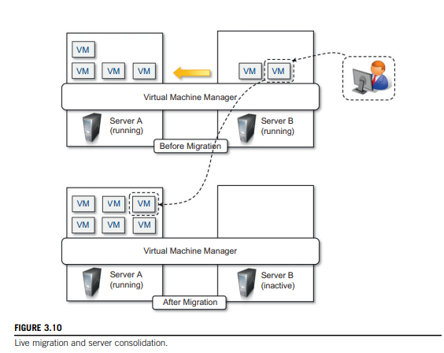
Virtualization And Cloud Computing:

Slide 35
Virtualization And Cloud Computing:
Because virtual machine instances are controllable environments, consolidation can be applied with a minimum impact, either by temporarily stopping its execution and moving its data to the new resources or by performing a finer control and moving the instance while it is running.
This second techniques is known as live migration and in general is more complex to implement but more efficient since there is no disruption of the activity of the virtual machine instance.
Server consolidation and virtual machine migration are principally used in the case of hardware virtualization, even though they are also technically possible in the case of programming language virtualization.
Storage virtualization constitutes an interesting opportunity given by virtualization technologies, often complementary to the execution of virtualization.
Even in this case, vendors backed by large computing infrastructures featuring huge storage facilities can harness these facilities into a virtual storage service, easily partitionable into slices. These slices can be dynamic and offered as a service.
Again, opportunities to secure and protect the hosting infrastructure are available, as are methods for easy accountability of such services.
Finally, cloud computing revamps the concept of desktop virtualization, initially introduced in the mainframe era.
The ability to recreate the entire computing stack—from infrastructure to application services—on demand opens the path to having a complete virtual computer hosted on the infrastructure of the provider and accessed by a thin client over a capable Internet connection.

Slide 36
Technology Examples:
A wide range of virtualization technology is available especially for virtualizing computing environments.
The most relevant technologies and approaches utilized in the Cloud-specific solutions are:
Xen: Paravirtualization
Vmware: Full Virtualization
Microsoft Hyper-V

Slide 37
Use this Link for Technology Examples:
Click on the below link-
https://slideplayer.com/slide/13501163/

Slide 38
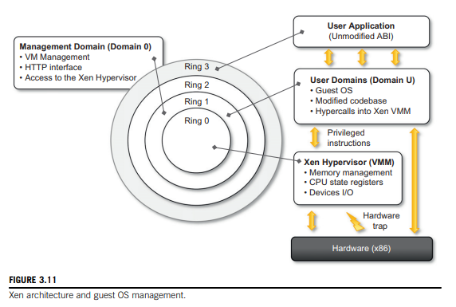
Technology Examples:
Xen: Paravirtualization

Slide 39
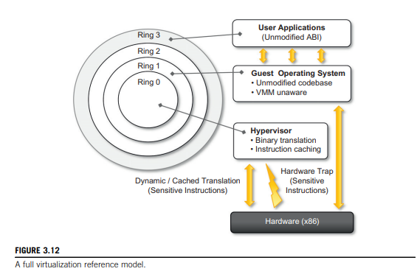
Technology Examples:
VMware: Full Virtualization
Full Virtualization and Binary Traslation

Slide 40
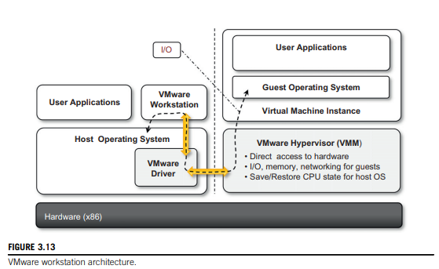
Technology Examples:
VMware: Full Virtualization
Virtualization Solutions
End-User (Desktop) Virtualization

Slide 41
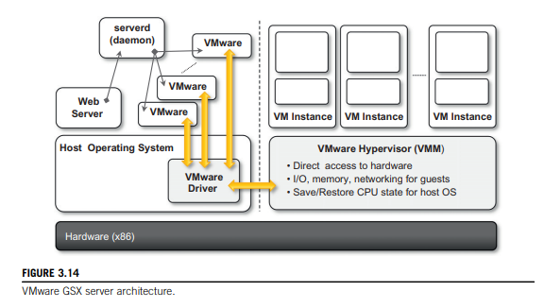
Technology Examples:
VMware: Full Virtualization
Virtualization Solutions
Server Virtualization(VMware GSX Server)

Slide 42
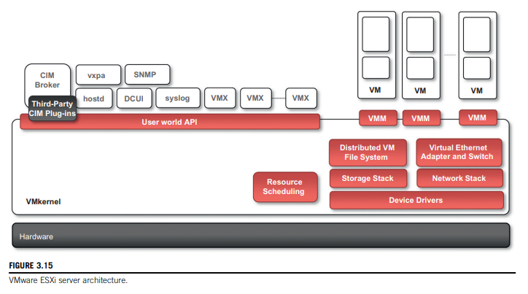
Technology Examples:
VMware: Full Virtualization
Virtualization Solutions
Server Virtualization(VMware GSXi Server)

Slide 43
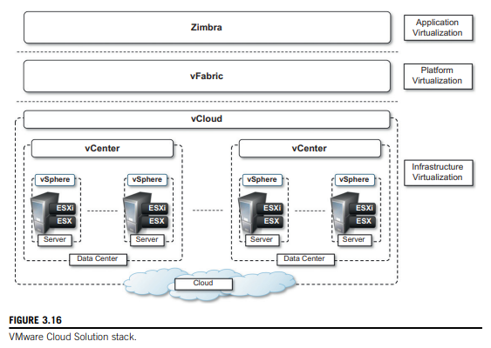
Technology Examples:
VMware: Full Virtualization
Virtualization Solutions
Infrastructure Virtualization & Cloud-Computing Solutions

Slide 44
Migrating into a Cloud
The Promises of the Cloud
The Cloud Services Offerings and Deployment Models
Challenges in the Cloud

Slide 45
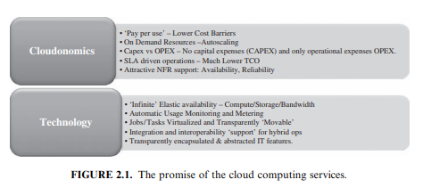
Migrating into a Cloud
The Promises of the Cloud

Slide 46
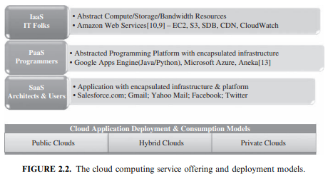
Migrating into a Cloud
The Cloud Services Offerings and Deployment Models

Slide 47
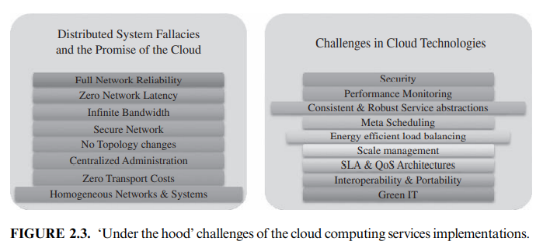
Migrating into a Cloud
Challenges in the Cloud

Slide 48
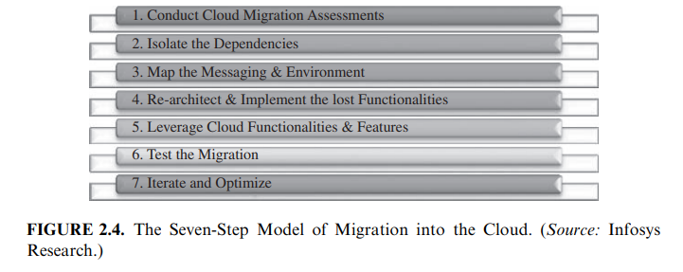
Migrating into a Cloud
The Seven-Step Model of Migration Into a Cloud

Slide 49
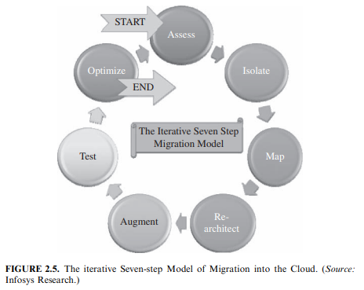
Migrating into a Cloud
The Seven-Step Model of Migration Into a Cloud

Slide 50
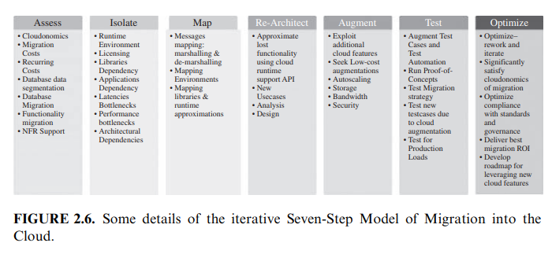
Migrating into a Cloud
The Seven-Step Model of Migration Into a Cloud

